Slide 1
Broadband accessibility and the digital divide
Bhargav Pathuri
MLPP 2025

Slide 2
Introduction:-
Broadband Accessibility: A Critical Digital Divide
Essential for education, healthcare, employment, and civic engagement.
Despite digital advancements, disparities persist, affecting rural areas, low-income households,
and marginalized groups.
Effects:
Educational Disparities: Limited access to online learning resources for rural and low-income students.
Economic Inequality: Restricted job opportunities and remote work due to connectivity issues.
Healthcare Gaps: Poor telehealth access in underserved and rural areas.
Project Focus: Identifying key barriers contributing to broadband inaccessibility.

Slide 3
Problem Statement
This project aims to investigate disparities in broadband accessibility across U.S. counties by identifying key factors that contribute to the digital divide. Using geospatial and demographic data, the study will explore patterns in broadband availability and affordability, perform exploratory visualizations, and apply machine learning techniques such as classification, regression, and clustering to uncover underlying socioeconomic drivers of limited access.

Slide 4
Datasets and Sources
1️. ACS 5-Year Estimates (2019-2023) - Social Characteristics (DP02)
●Description: Provides insights into educational attainment, digital literacy, and household internet use, which are key indicators of the digital divide.
2. ACS 5-Year Estimates (2019-2023) - Economic Characteristics (DP03)
●Description: Helps understand income disparities, affordability of broadband services, and the correlation between poverty and digital exclusion.
3️. ACS 5-Year Estimates (2019-2023) - Demographic and Housing Characteristics (DP05)
●Description: Provides demographic breakdowns, which help analyze racial and age-based disparities in broadband access.
4️. ACS Supplemental Population Estimates (S0201) (2023)
●Description: Used to estimate population subgroups, household size, and digital literacy indicators.
5️. ACS 5-Year Estimates (2019-2023) - Internet and Computer Use (S2801)
●Description: Directly relates to the problem statement by measuring internet and broadband accessibility, device ownership, and disparities in connectivity.
Datasets source:- https://data.census.gov/

Slide 5
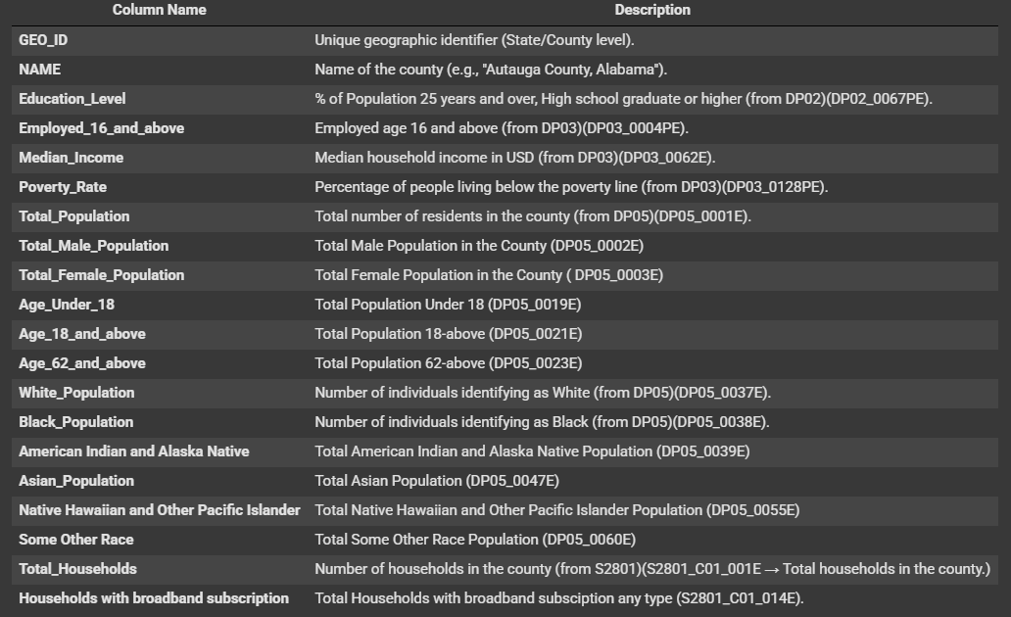
Merged Dataset and Data Dictionary

Slide 6
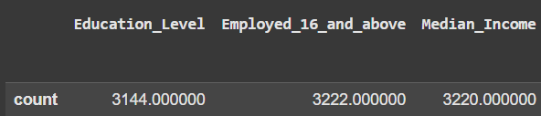
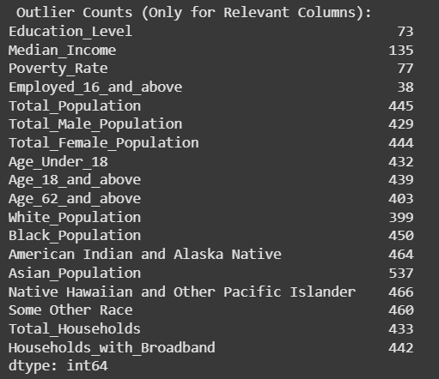
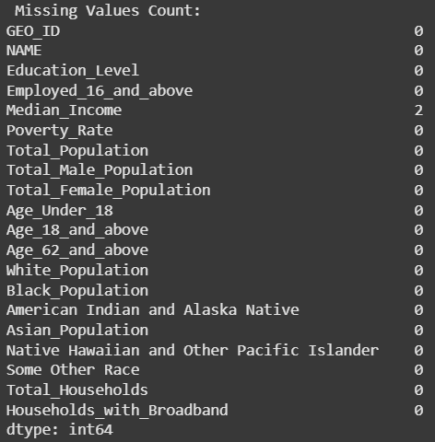
Summary Statistics
“Puerto Rico” rows missing in Education level, and in remaining variables it has “null values”.

Slide 7
Data Preprocessing
●All Puerto Rico rows have been removed.
●Only 2 missing values in “Median Income”, (Filled missing values with the overall U.S. median income. This is reasonable since only 2 values are missing, and median imputation won’t distort the distribution.)
Outliers:- Found Outliers in Key Columns, but not treated because:-
Outliers were retained to preserve the accuracy and representativeness of the analysis. In socioeconomic data, extreme values often reflect real-world disparities—such as high incomes in affluent regions or low broadband access in rural areas—rather than errors. Removing them would hide key patterns related to the digital divide.
Now the Data is clean moving to the Initial analysis and Visualizations…..

Slide 8
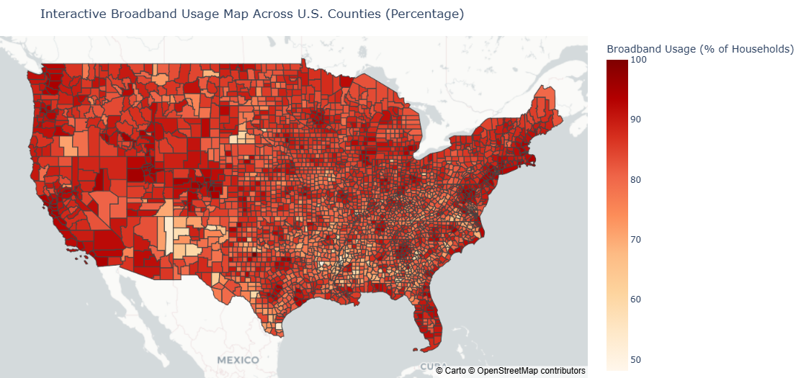
Initial Analysis & Visualizations
The map illustrates the percentage of households with broadband access across U.S. counties, with darker shades representing higher broadband usage.
Majority of the counties has high broadband usage.
Median Broadband percentage: 85.27

Slide 9
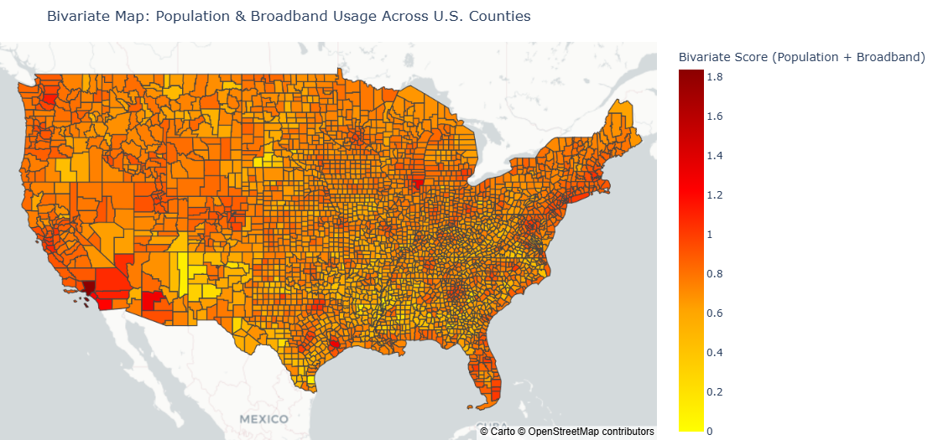
The visualization highlights areas where higher population density coincides with higher broadband access
Very few counties has
Score > 1
Confirming Total population has minimal impact on Broadband usage

Slide 10
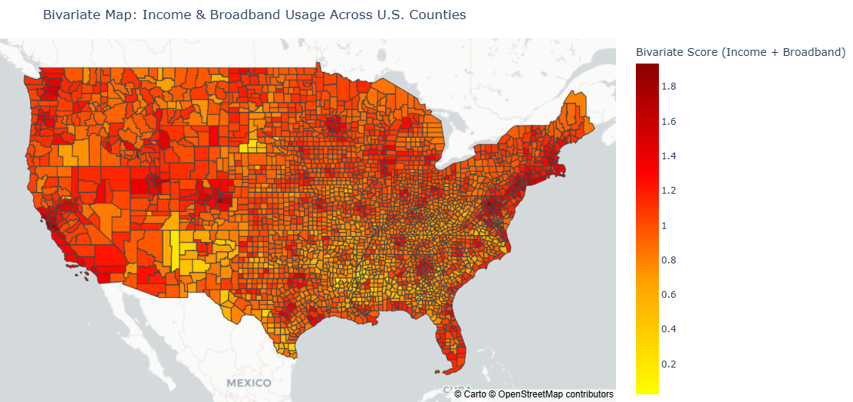
The visualization illustrates regions where higher income aligns with higher broadband access, emphasizing the correlation between economic status and digital connectivity.
Many counties has
Score > 1
Confirming Income has very high impact on Broadband usage

Slide 11
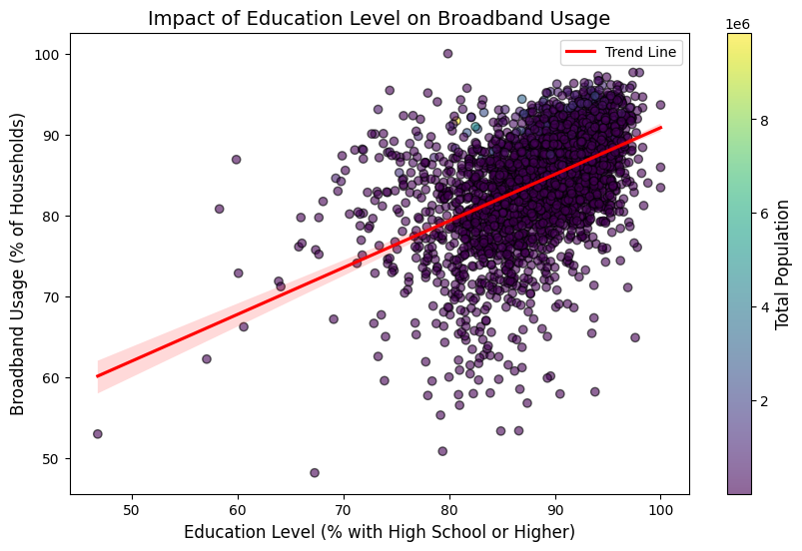
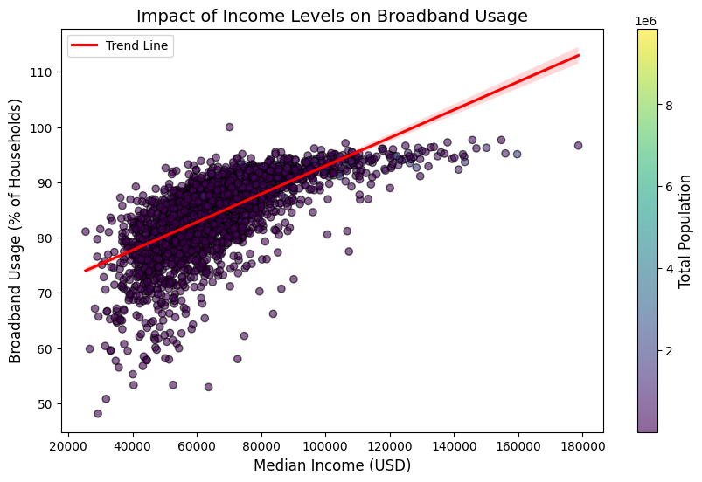
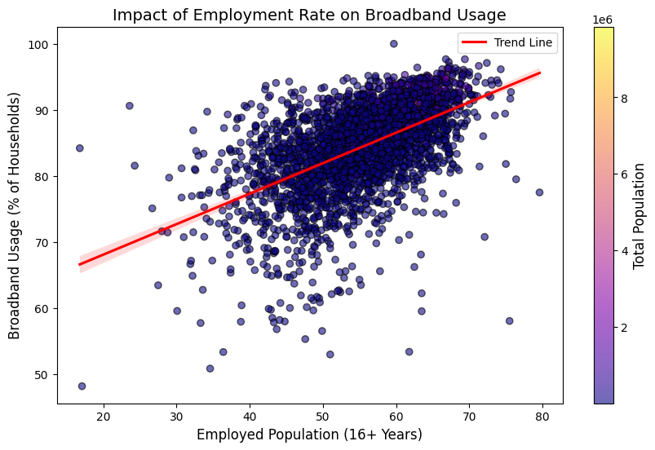
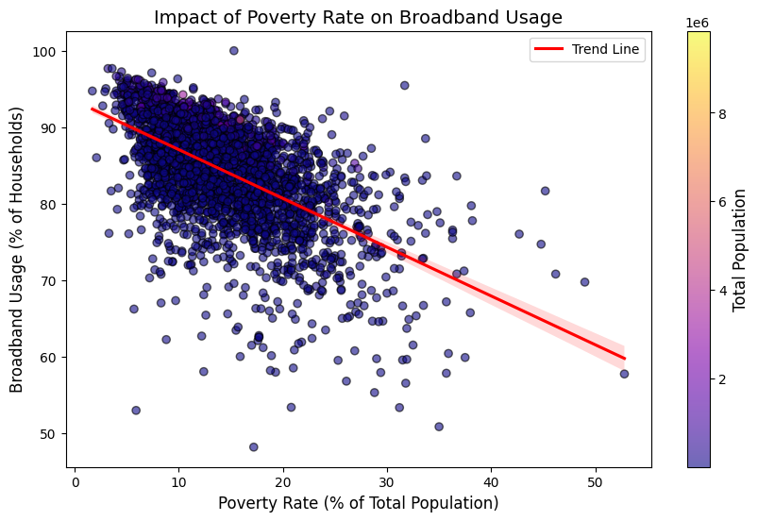
Positive correlation
Positive correlation
Impact of Socio-economic features on Broadband usage
Positive correlation
Negative correlation

Slide 12
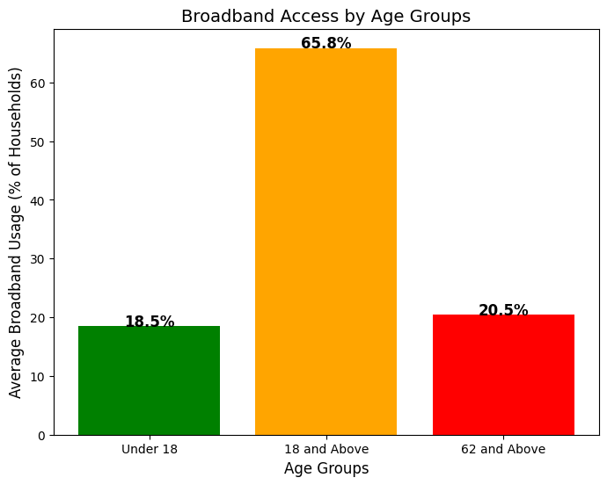
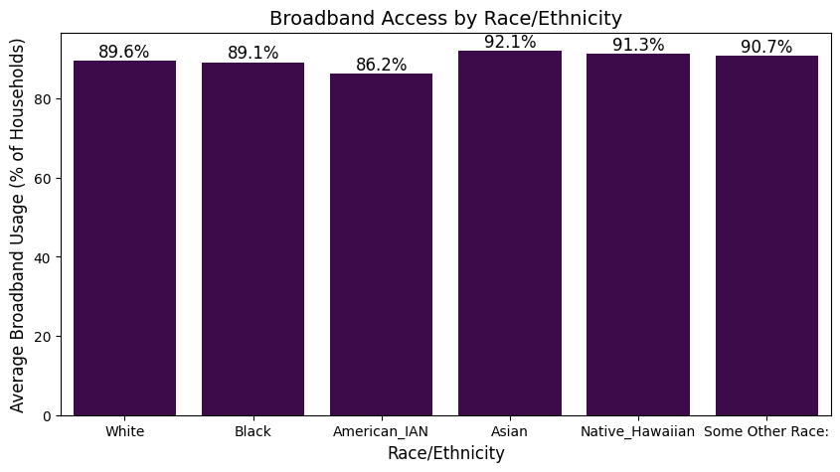
Impact of Age & Race
Working age group has high broadband usage.
All Races have good broadband access, confirming Race has a very minimal impact.

Slide 13
Initial Analysis Summary
The initial analysis and visualizations identified median income, education level,
employment, poverty rate, and the population aged 18 and above as the major key factors
influencing broadband access.
however, further analysis through machine learning models is necessary to quantify these relationships.
Employing regression or classification models will help determine the extent to which these features impact
broadband usage and identify the most influential factors.
Now moving to Methods and Results…….

Slide 14
Methods & Results
Classification Task - Random Forest Classifier
Why this method??
A Random Forest Classifier was selected for its robustness against overfitting, ability to handle complex feature interactions, and capacity to assess feature importance effectively.
Target ??
Features:-
["Education_Level", "Median_Income", "Poverty_Rate", "Employed_16_and_above", "Age_18_and_above"]

Slide 15
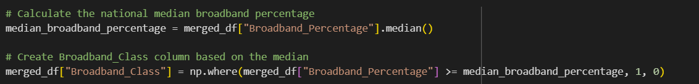
Target → Broadband Class
Procedure:
The national median broadband percentage was calculated to serve as a threshold value.
Counties with broadband usage equal to or above the median were assigned a class label of 1 (Well-Connected).
Counties with broadband usage below the median were assigned a class label of 0 (Underserved).
Why this for classification as a target?
This method facilitates balanced binary classification based on broadband access using the median as a threshold, enabling the identification of counties with lower access and the exploration of underlying socioeconomic factors.
Objective:
The classification task aims to determine the extent to which socioeconomic disparities contribute to broadband accessibility in different counties.

Slide 16
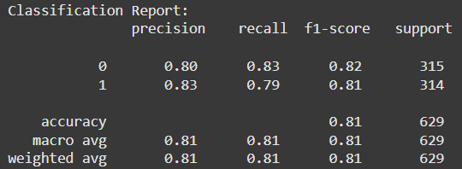
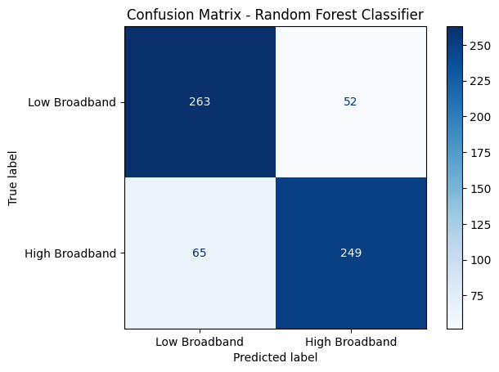
Results and analysis (Key metrics)
The F1-score, balancing precision and recall, is 0.82 for Low Broadband and 0.81 for High Broadband, showing comparable model performance for both classes.
The overall accuracy of the model is 81%, indicating that the model correctly classified broadband access levels in 81% of cases.
Confusion Matrix:
The confusion matrix reveals that the model correctly classified:
263 counties as Low Broadband (True Negatives)
249 counties as High Broadband (True Positives)
Misclassifications include:
52 counties falsely classified as High Broadband (False Positives)
65 counties falsely classified as Low Broadband (False Negatives)
The confusion matrix highlights a slight bias towards classifying High Broadband counties as Low Broadband, as indicated by the higher count of false negatives.

Slide 17
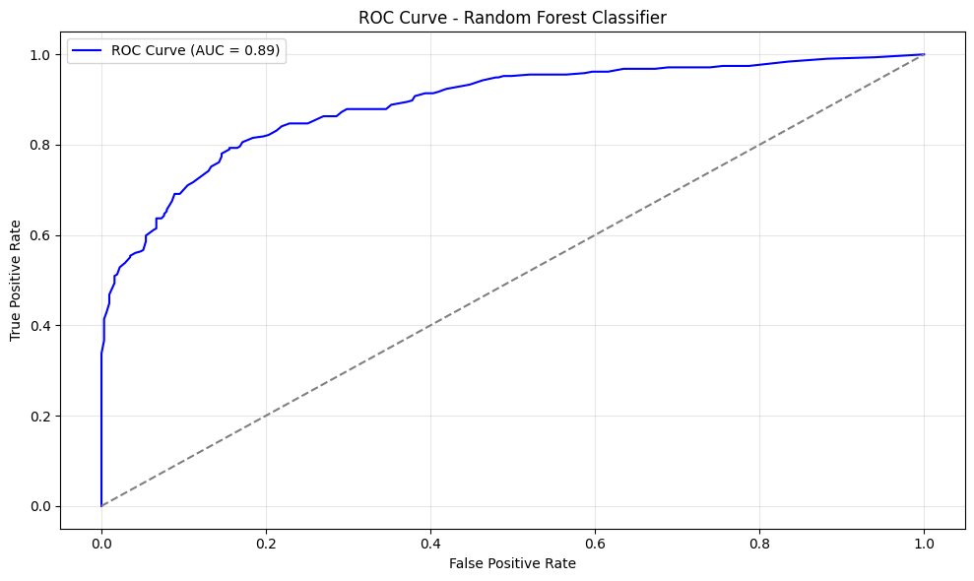
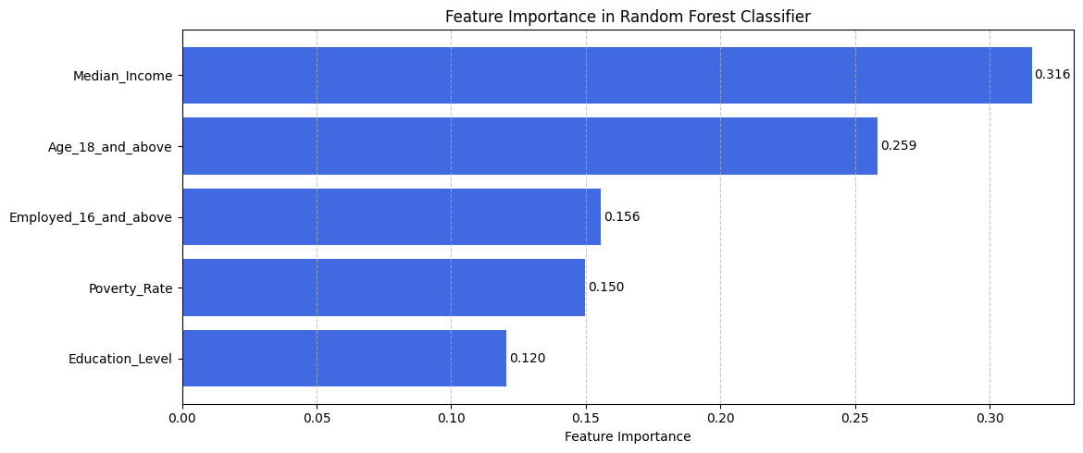
ROC Curve and AUC Score:
The ROC curve plots the trade-off between the True Positive Rate and False Positive Rate at various thresholds.
The Area Under the Curve (AUC) is 0.89, indicating strong model performance in distinguishing between the two classes.
Feature Importance Analysis:
The feature importance plot ranks the features based on their contribution to the model’s predictive accuracy.
Median Income (0.316) is identified as the most influential feature, followed by Age 18 and Above (0.259).
Other features — Employed 16 and Above (0.156), Poverty Rate (0.150), and Education Level (0.120) — also contribute to the model but to a lesser extent.
Next step to use hyper parameter tuning to improve the model accuracy…

Slide 18
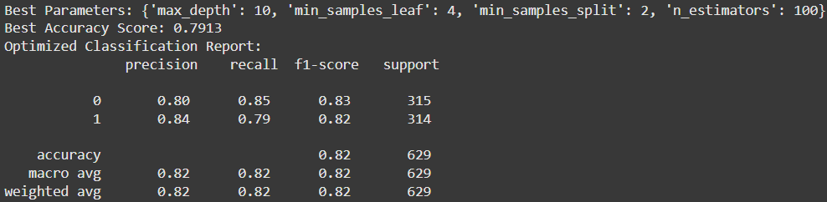
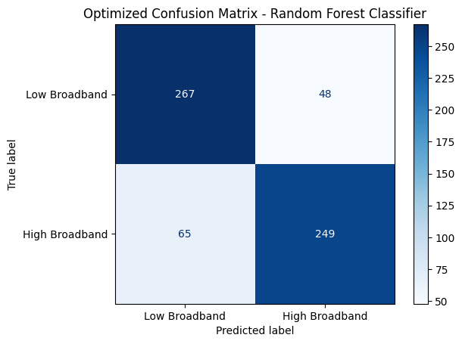
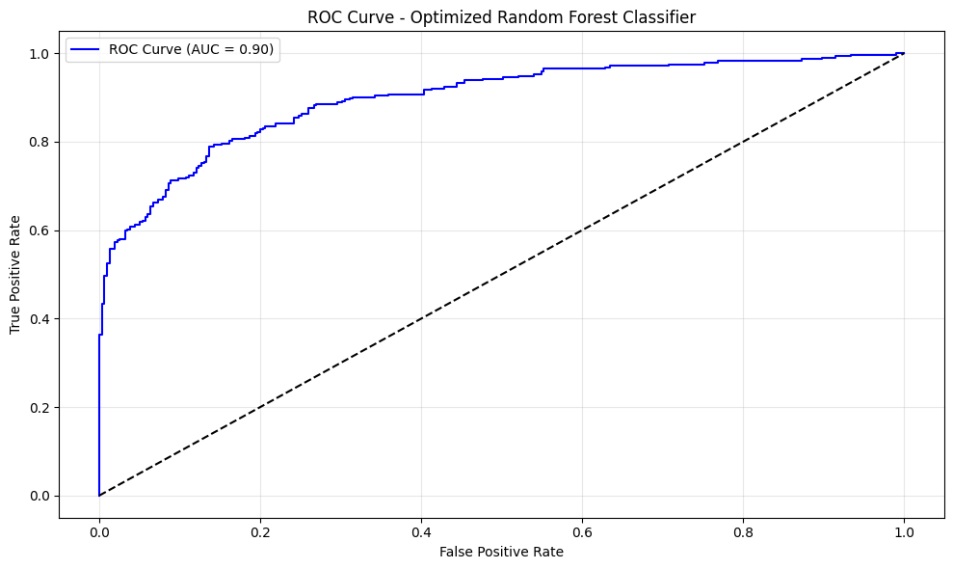
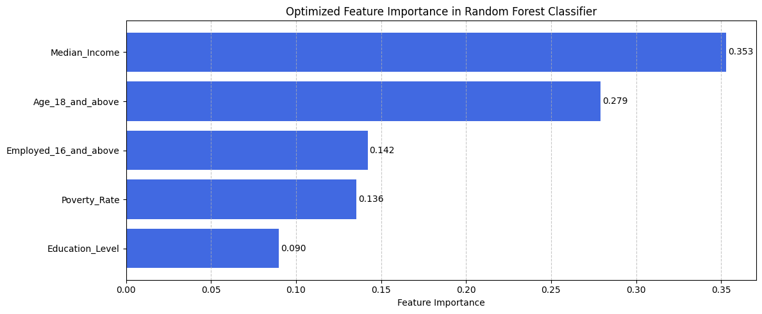
Results after Hyperparameter tunning using GridSearchCV
Best parameters found
Accuracy improved from 81 to 82%
The number of correctly classified Low Broadband counties increased from 263 to 267, reducing false positives from 52 to 48.
The AUC score increased from 0.89 to 0.90, indicating a marginal improvement in the model’s ability to distinguish between the two classes effectively. The feature importance ranking remained consistent, with Median Income (0.353) and Age 18 and Above (0.279) remaining the most influential predictors and values slightly changed.

Slide 19
Classification task Summary
The selected features — Education Level, Median Income, Poverty Rate, Employment (16 and above), and Age (18 and above) — collectively predicted broadband access levels with an accuracy of 81%, indicating a strong predictive capability. Median income emerged as the most influential factor, suggesting that further exploration of other features could potentially enhance the remaining 19% prediction accuracy.

Slide 20
Regression Task - Random Forest Regressor
Why this method??
A Random Forest Regressor was chosen for predicting , due to its ability to handle complex feature interactions and effectively assess feature importance in the regression task.
Target :-
Poverty_Rate why??
Features:-
["Education_Level","Median_Income","Employed_16_and_above","Total_Population","Broadband_Percentage"]

Slide 21
Poverty rate as a Target!!
Poverty rate exhibits a negative correlation with broadband usage, underscoring its significant impact. While other features like education, income, and age, employment rate are standard socioeconomic metrics, poverty uniquely represents a disparity and directly affects broadband access. By using poverty rate as the target variable in predictive modeling, we can identify key factors contributing to poverty, revealing the connection between economic and broadband disparities.
Negative correlation

Slide 22

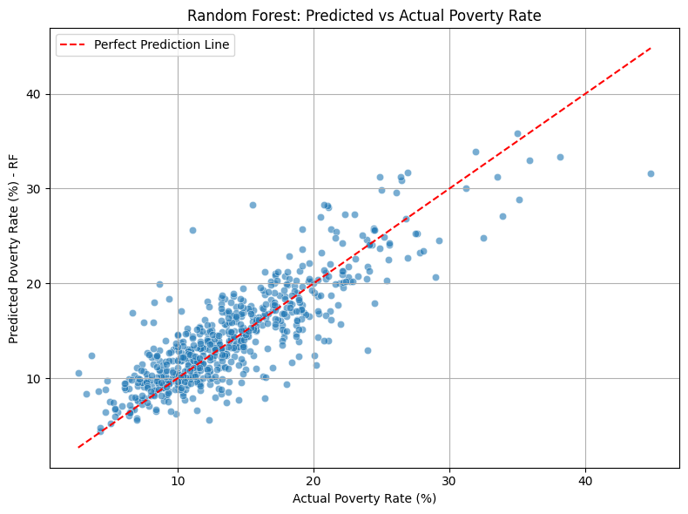
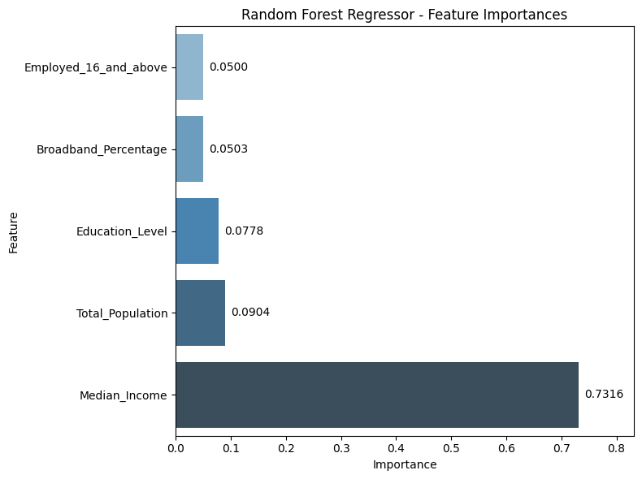
Results (Key Metrics)
The model demonstrated solid performance in predicting poverty rates, with a Mean Absolute Error (MAE) of 2.24 and a Root Mean Squared Error (RMSE) of 3.06, indicating relatively low prediction errors. Additionally, the R² score of 0.715 signifies that the model effectively captures 71.5% of the variance in poverty rates based on the selected socioeconomic features, though further refinement could address the remaining variance.
The dominance of Median Income underscores its strong association with poverty rates, aligning with the hypothesis that income disparity is a major factor influencing poverty and digital divide.
The scatter plot of predicted vs. actual poverty rates illustrates the model’s predictive accuracy, with most data points clustering around the ideal prediction line. While the model generally performs well, noticeable deviations and outliers highlight instances of underestimation or overestimation, indicating areas for potential model refinement.

Slide 23
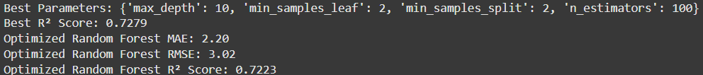
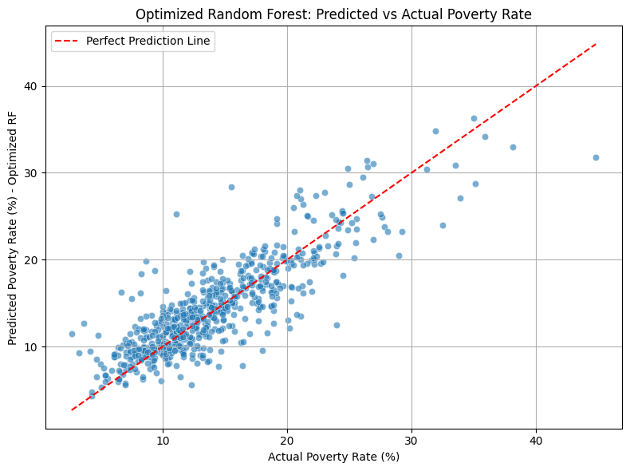
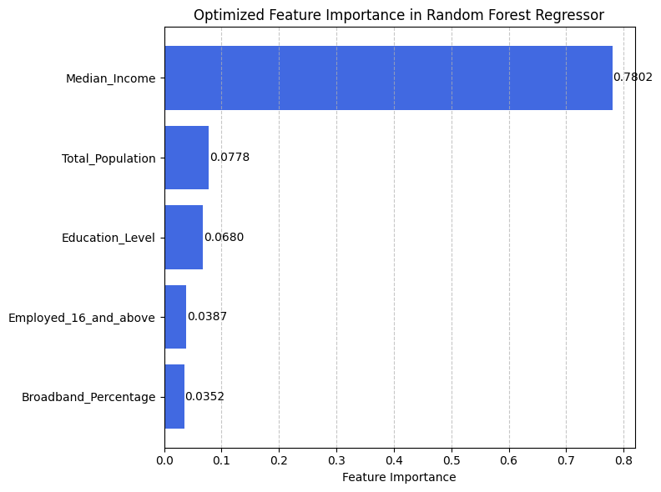
Results after Hyperparameter tunning using GridSearchCV
The model's performance slightly improved, with the R² score increasing to 0.7223, indicating a better fit. The MAE decreased to 2.20, and the RMSE reduced to 3.02, reflecting more accurate predictions. The scatter plot shows a tighter clustering around the prediction line, while Median Income (0.7802) remains the most influential predictor, reinforcing its dominant impact on poverty rate predictions.

Slide 24
Regression Task Summary
The regression analysis clearly shows that 72% of the changes in poverty rates are explained by the features, with median income being the strongest predictor, confirming the hypothesis that income affects poverty levels. Similarly, in the classification task, median income was the main factor in predicting broadband access, strongly supporting the connection between economic status and broadband access.

Slide 25
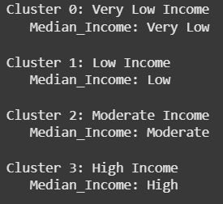
Clustering Task – K-Means Clustering
Clustering on? And why?
Both the classification and regression tasks consistently highlighted Median Income as the most impactful feature, influencing both broadband access classification and poverty prediction. By clustering counties based solely on income levels, we can effectively explore how income disparities align with broadband access patterns, identifying distinct income-based groups and analyzing their broadband access distribution.
Why this method??
K-Means Clustering was chosen to group counties based on income similarities, allowing for the identification of income-based clusters effectively. This method is computationally efficient and provides clear groupings, enabling analysis of how broadband access varies across different income levels, highlighting potential digital divide patterns.

Slide 26
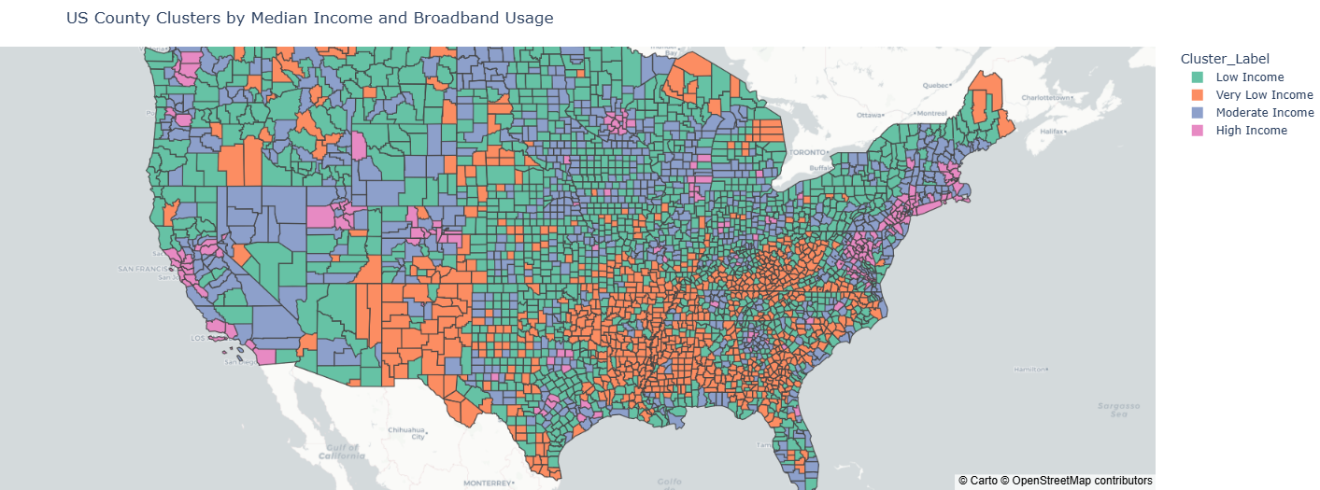
California
Shasta County
Trinity County
Mendocino County
Sonoma County
High Income Cluster - Sonoma County:
Median Income: $102,840
Employment Rate: 61%
Poverty Rate: 8.6%
Broadband Percentage: 94.03%
Moderate Income Cluster - Shasta County:
Median Income: $71,931
Employment Rate: 52.4%
Poverty Rate: 13%
Broadband Percentage: 89.52%
Low Income Cluster - Mendocino County:
Median Income: $64,688
Employment Rate: 51.1%
Poverty Rate: 15.2%
Broadband Percentage: 87.05%
Very Low Income Cluster - Trinity County:
Median Income: $53,498
Employment Rate: 37.2%
Poverty Rate: 18%
Broadband Percentage: 79.25%
Clearly showing the income-employment-poverty triad influence on the broadband usage, there are more examples like this in the Map

Slide 27
Final Conclusion
The summary statistics and initial analysis identified key features influencing broadband usage. The classification and regression models further confirmed that Median Income is the most impactful factor, underscoring that the primary cause of broadband accessibility issues and the digital divide is rooted in affordability and economic disparities.
The clustering task effectively segmented counties based on income levels, further reinforcing the influence of the income-employment-poverty triad on broadband usage, aligning closely with census data patterns.
Future Work:
While we identified key factors influencing broadband usage, some accuracy and variance remain unexplained. Exploring additional features from other datasets could potentially enhance prediction accuracy and uncover more patterns.

Slide 28
Thank You!!

